Slide 1
Student Attendance Tracking
Group B - Code Green
Sirisha Vanamali
Rohith Babu sadhu
Sri Sai Ram Kumar Mamidala
Vamsi Devalla
Subba Reddy Pothireddy
Vipul Reddy Madadi
Shankar Rao Vallapurapu

Slide 2
Contents
Problem Statement
Existing Systems
Requirements
Project Management Plan
Use Cases diagrams
Implementation Strategy
Challenging Issues
Status
Estimated Effort

Slide 3
Problem Statement
We want to develop a system which makes the life of an instructor easy in terms of tracking the attendance of a student with minimum effort.
Today, we are using different traditional ways which have certain limitations, ignoring them would make people easier to abuse them.
We will be using the QR codes for tracking the attendance of the students.

Slide 4
Existing Systems
Magnetic chip readers
Installing new hardware devices
Time constraint
Sign sheet
Time constraint
Easy abuse
Roll call
Time constraint
Finger Prints
Expensive
Installing new hardware devices

Slide 5
Requirements
Instructor
QR code Generation
Manage the students attendance
Admin
Manage courses
Manage student
Manage Instructor
Manage QR code

Slide 6
Requirements (Cntd…)
Student
Scan QR and Capture it
View courses registered
View attendance percentage
Feedback

Slide 7
Project Management Plan
Project Deliverables
Mobile app
QR code scanner
QR code Image
Stand alone application
QR code generator
Retrieving the Student details

Slide 8
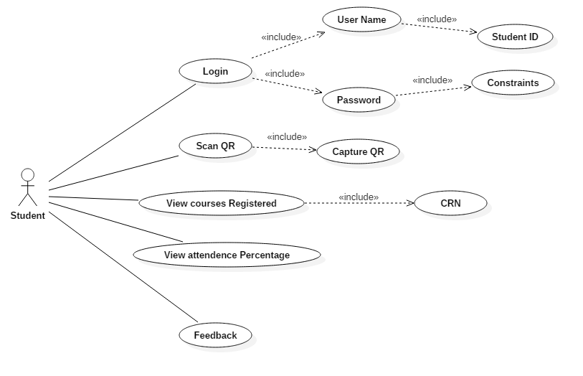
Use Case Diagrams
Student Use case

Slide 9
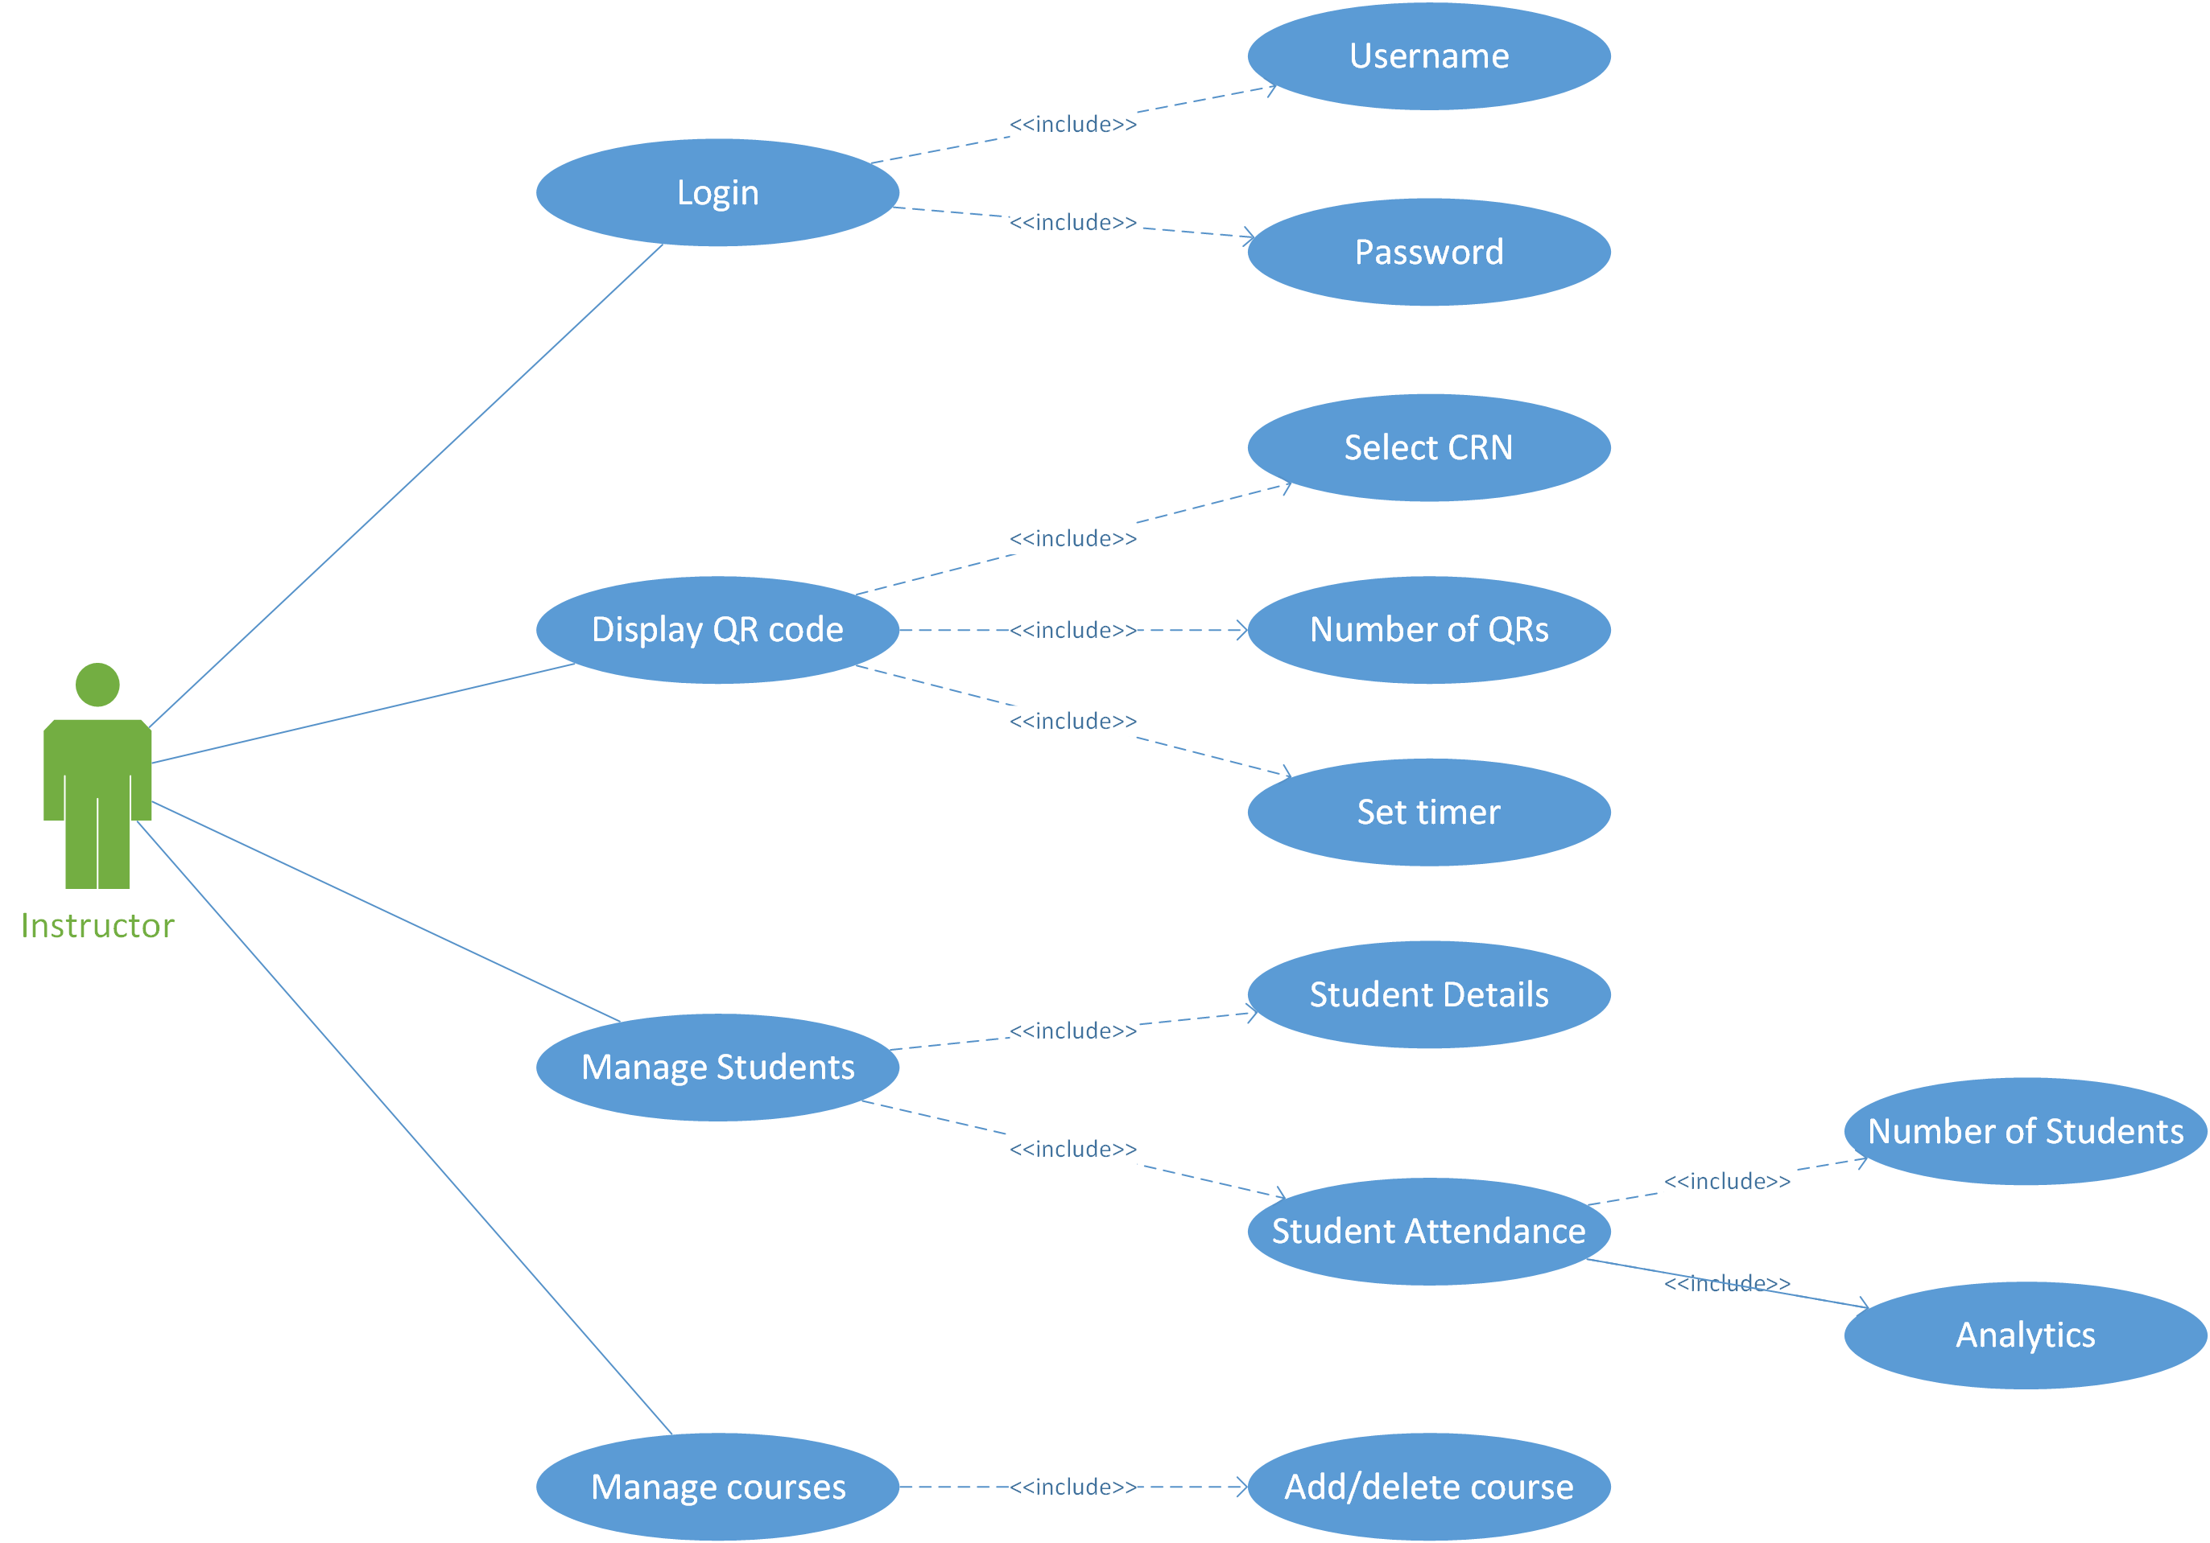
Instructor Use Case

Slide 10
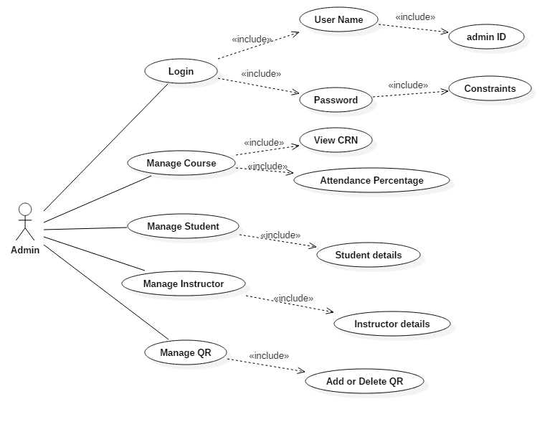
Use Case
Admin Use case

Slide 11
Status
We are currently working on documenting the requirements
We have currently acquired around a 40 requirements for the project.
Use Case diagrams of the project.
Working on use case diagram description

Slide 12
Challenging issues
Generation of the Unique QR code for each time.
QR codes generated from two standalone applications are different.
Database that can connect cross platform applications for no cost.
Getting more than one response from single mac address.
Scanning and capturing QR code in a single click.

Slide 13
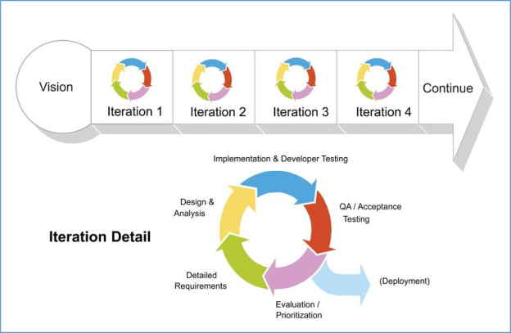
Implementation Strategy
Describing requirements in a clear and precise manner for understanding the project overview.
Developing a prototype would allows us to create an graphical view of the project.

Slide 14
Estimated efforts for completion of the project
Our rough estimation is around 15000 lines of code
We have spent 52 hours within this 2 weeks (15 hrs first week + 37 hrs second week)
Equal distribution of tasks among team members.
About 5180 hours of combined team work in GDP 1 and 2.

Slide 15
Thank you

